Slide 1







React.js Installation & Hello World
Why React & How To Get Started
React.js Development
SoftUni Team
Technical Trainers
Software University
http://softuni.bg

Slide 2

Table of Contents
Why React?
Why React is better than the others
Installation
A simple process to get started
Building our first application
The usual Hello World app

Slide 3
Have a Question?
sli.do #react-js

Slide 4
Why React?
What The Fuzz Is All About

Slide 5
Why React?
React is:
Fast – super fast framework – the Facebook app uses it
Composable – easily differentiate huge components
Pluggable – tons of plugins and additional functionalities
Isomorphic – can be rendered on both the client and the server
Simple – very simple to use built-in API
Battle Proven – Facebook again?

Slide 6
Why React?
Used by:
Facebook
PayPal
Dropbox
Netflix
Reddit
Many others

Slide 7
What is React?
Most other frameworks use the MV* pattern
Angular
Ember
Knockout
React is more like the V + C in one place
You have a view directly in the "controller"
Everything is in one place
Also – does not use two-way binding like the others

Slide 8
What is React?
React introduces a "new" language on top of JS
It is called JSX and it's a mix between "HTML" & JS
It may look scary at first, but you will like it
The "HTML" part is a bit different but no too much
Compiles to plain old JavaScript
It's optional but highly recommended
Can be used with both ES5 & ES2015

Slide 9
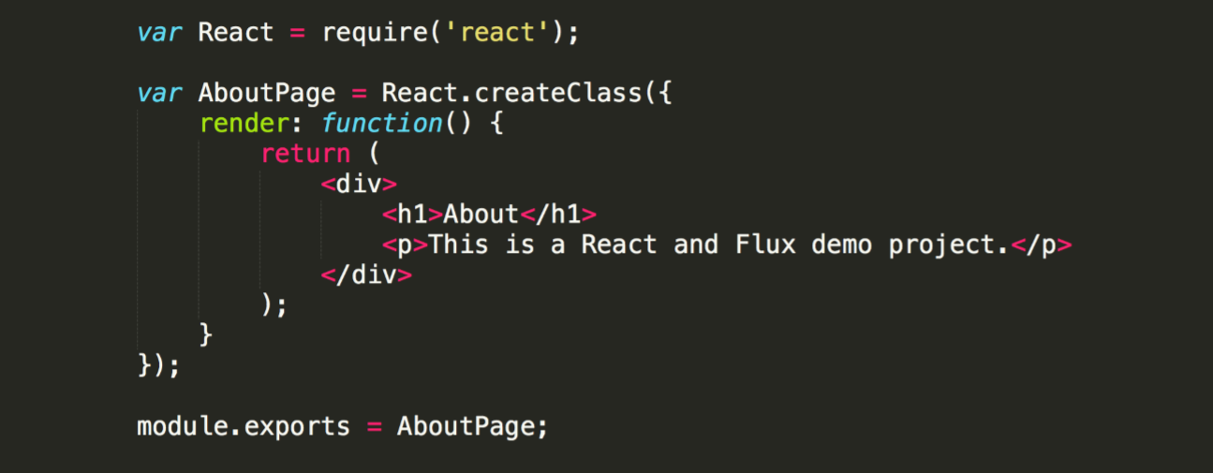
What The Hell Is This JSX?
Note: this example is in ES5
What is going on?
<h1 color="red">Heading here</h1>
React.createElement("h1", {color: "red"}, "Heading here")

Slide 10
What About Separation Of Concerns?
You may wonder how React implements separation of concerns
It does by using components, however
Using "HTML" & JS in one place makes it easier to spot bugs
Making the view inline gives you a better UI development experience
Most other frameworks use "JS" in the HTML
React makes it opposite – "HTML" in JS
<div ng-repeat="user in users">
{{#each user in users}}

Slide 11
React.js Valuable Features?
Typo? No worries. JSX tells you every single mistake you made
Virtual DOM – updates only the changed part of the UI
Without it – blindly update DOM using state
With it – compare DOM's current state to the desired new state and update only the change in a most efficient way
For example removing a row from a table
Other frameworks may redraw the whole table because a single row was removed
React will only remove the necessary row and will not touch any other element
Synthetic Events – optimized event handlers
Isomorphic Support – can renders on both the client and the server

Slide 12
You Impressed? Let's Install It
It's very simple actually

Slide 13
Creating A New App
Pretty easy actually, Facebook made it for us
Install globally create-react-app and serve
Use it like this
These commands will start a dev server on port 3000
To make production build just run
npm install -g create-react-app
create-react-app some-app
cd some-app
npm start
npm run build
serve –s build

Slide 14
What About The IDE?
We will use Visual Studio Code
But you may use whichever IDE you prefer
You don't need to install anything specifically
It supports JSX & ES2015 out of the box
You may install the JavaScript Standard Style if you prefer it
It is not required but it's highly suggested
It will lint all your style errors
Additionally, you may install this Chrome plugin
https://chrome.google.com/webstore/detail/react-developer-tools/fmkadmapgofadopljbjfkapdkoienihi?hl=en

Slide 15
Let's Hack Some Code
A simple Hello World!

Slide 16








JavaScript Web – React.js Fundamentals
https://softuni.bg/trainings/1434/node-js-development-september-2016

Slide 17

License
This course (slides, examples, demos, videos, homework, etc.) is licensed under the "Creative Commons Attribution-NonCommercial-ShareAlike 4.0 International" license
Attribution: this work may contain portions from
"End-to-end JavaScript Applications" course by Telerik Academy under CC-BY-NC-SA license

Slide 18





Free Trainings @ Software University
Software University Foundation – softuni.org
Software University – High-Quality Education, Profession and Job for Software Developers
softuni.bg
Software University @ Facebook
facebook.com/SoftwareUniversity
Software University @ YouTube
youtube.com/SoftwareUniversity
Software University Forums – forum.softuni.bg

